Slide 1
Orangebox OTQT
Quick Tips

Slide 2
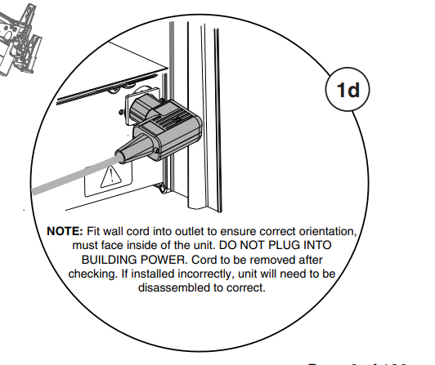
Bottom Power In Feed Install
The power connection that gets attached to the base needs to be installed so the wall cord’s right angle faces the middle and not the door.
This connection should go on the side labeled #1 on the base

Slide 3
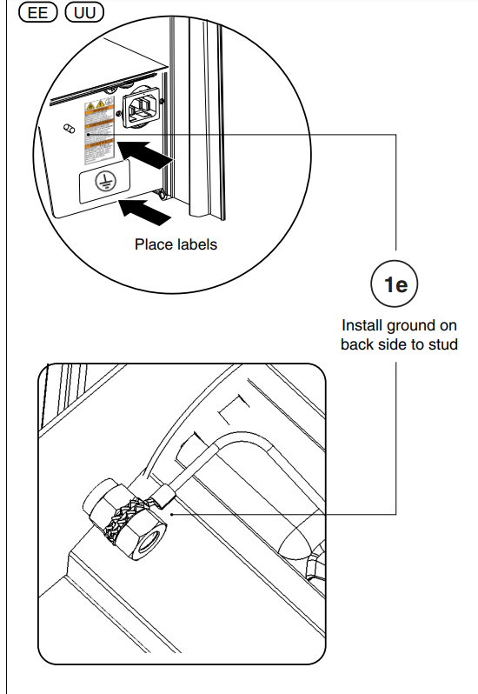
Bottom Power In Feed Install – Continued
These nuts should be M5x.8
Some of the first shipments of the electrical components have the wrong size nut included.

Slide 4
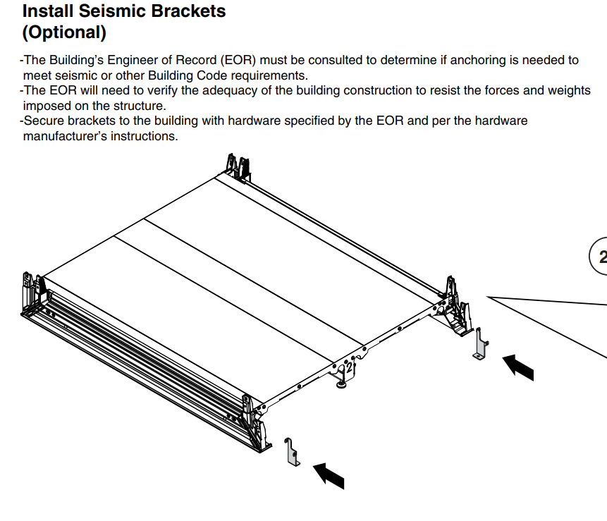
Install Seismic Brackets
If ordered, Seismic Kit brackets need to be added to the base Prior to the Walls, Window and Door being installed

Slide 5
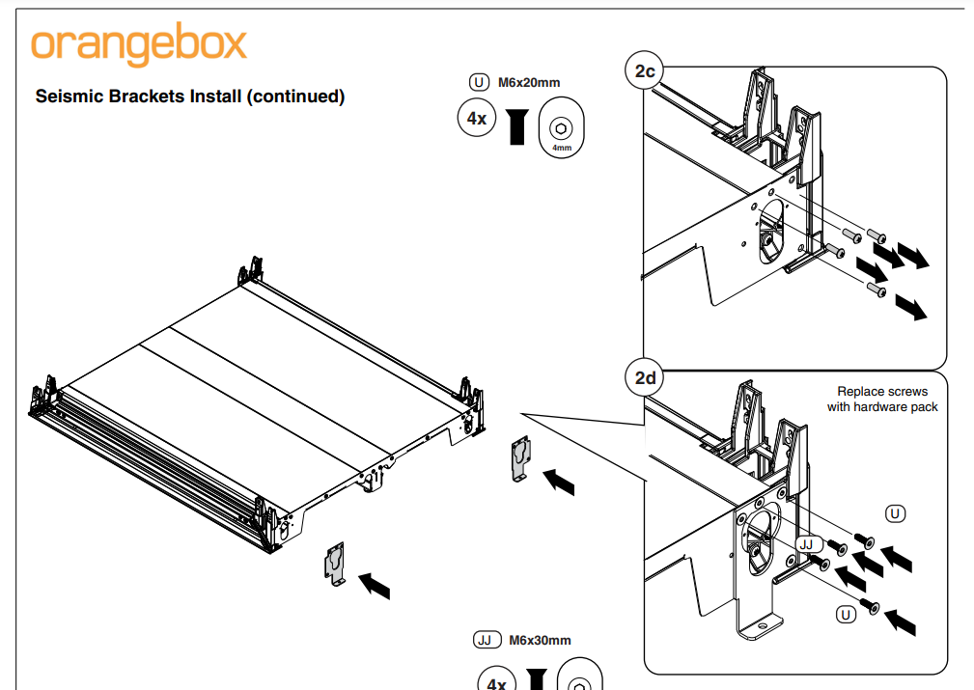
Install Seismic Brackets
Seismic Brackets for the front come with hardware that replace the preinstalled screws on the base

Slide 6
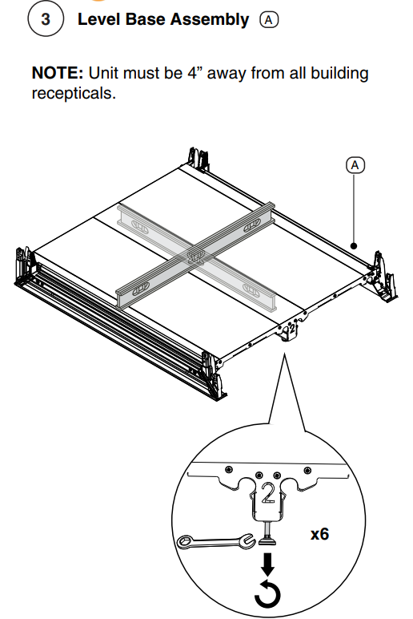
Level Base
Make sure base is level prior to adding the walls, window, and door

Slide 7
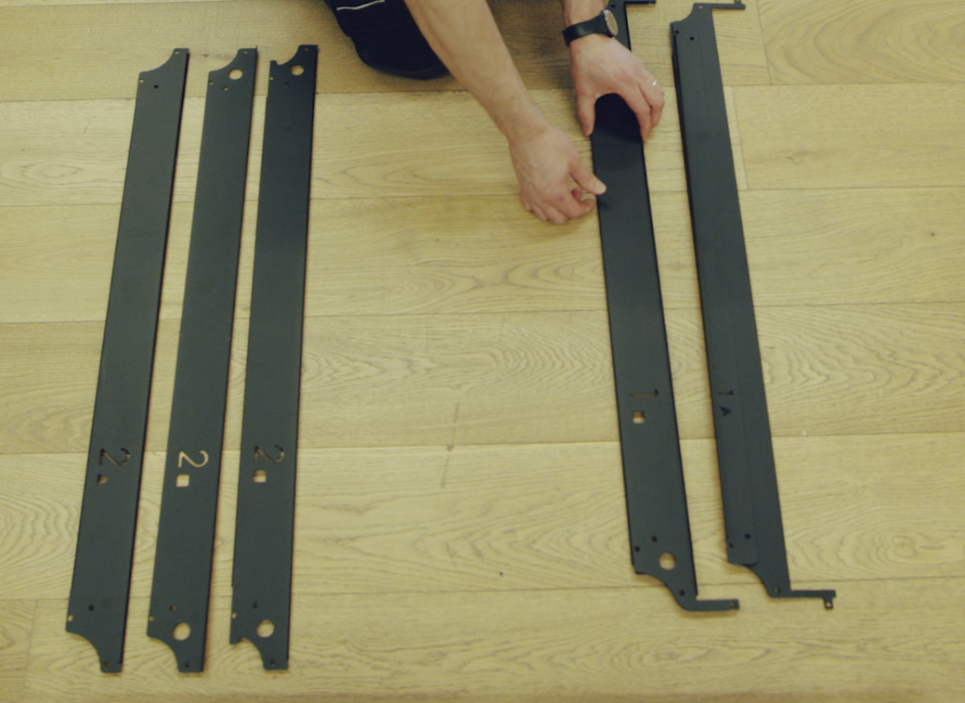
Adding Cross Brace Kit When Building the Tall Walls
Braces with the # 1 cut out go on the back wall and Braces with the # 2 cut out go on the front wall
Pieces with squares cut out go on the bottom and Triangles go on the top.

Slide 8
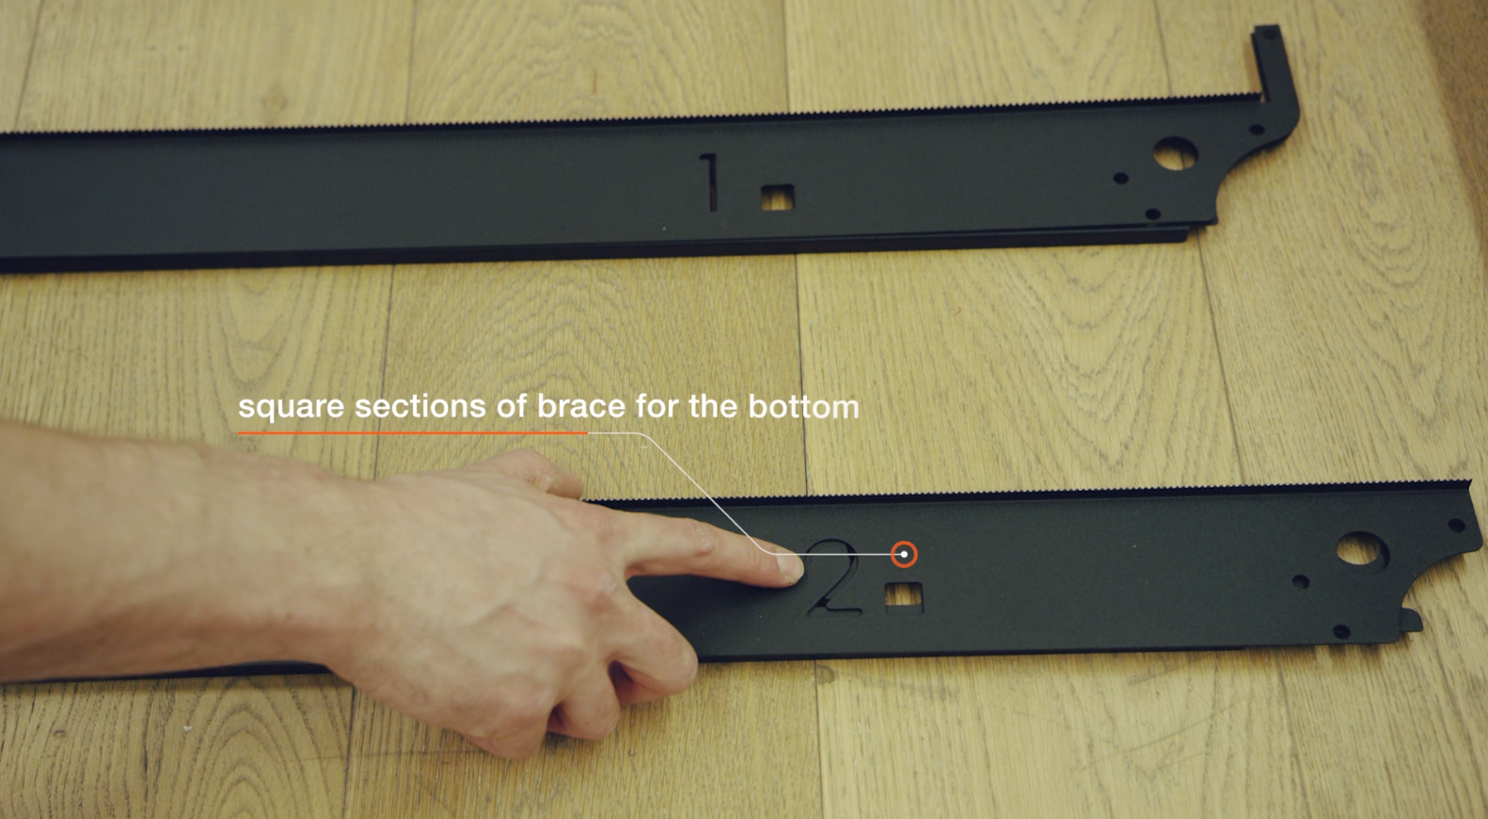
Adding Cross Brace Kit When Building the Tall Walls
Stack any braces on top of each other with matching number and shape
Align so you can see through both the number and shape cut out

Slide 9
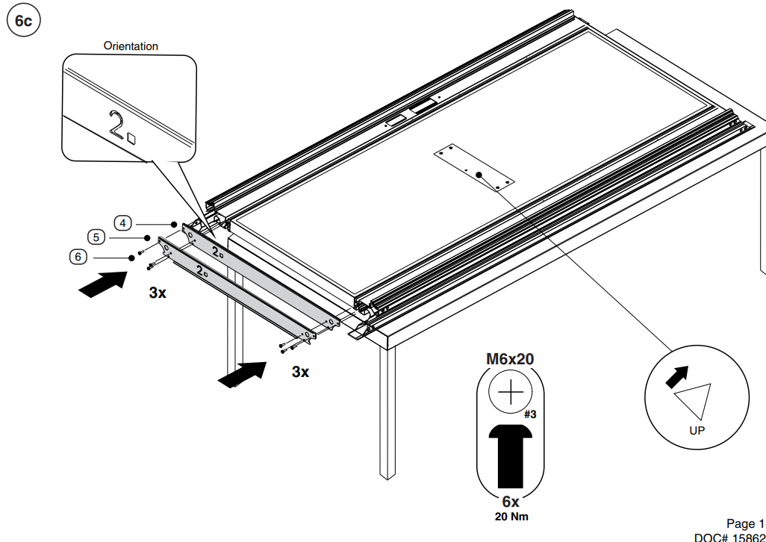
Adding Cross Brace Kit When Building the Tall Walls
Additional picture showing how the cross braces get stacked on top of each other

Slide 10
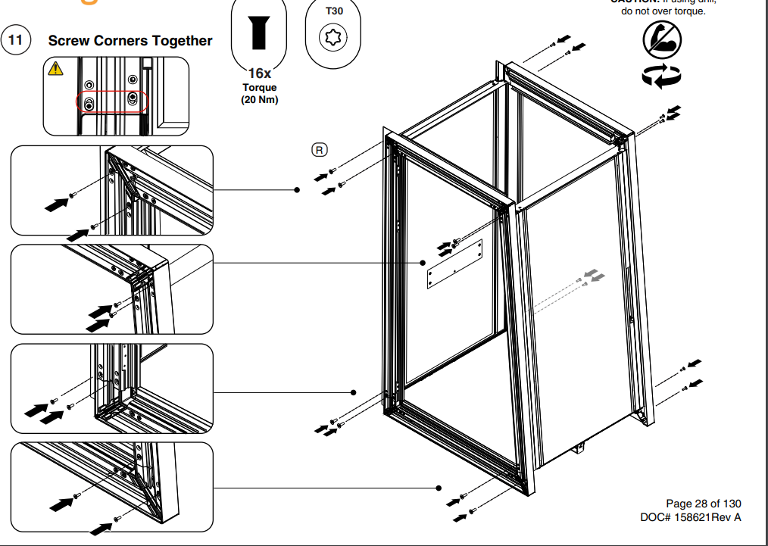
Screwing the Walls to the Base
Some of these holes in the base that hold the walls in place did not get tapped, you may need to tap them out with a M6x1.0 tap. See circled areas.

Slide 11
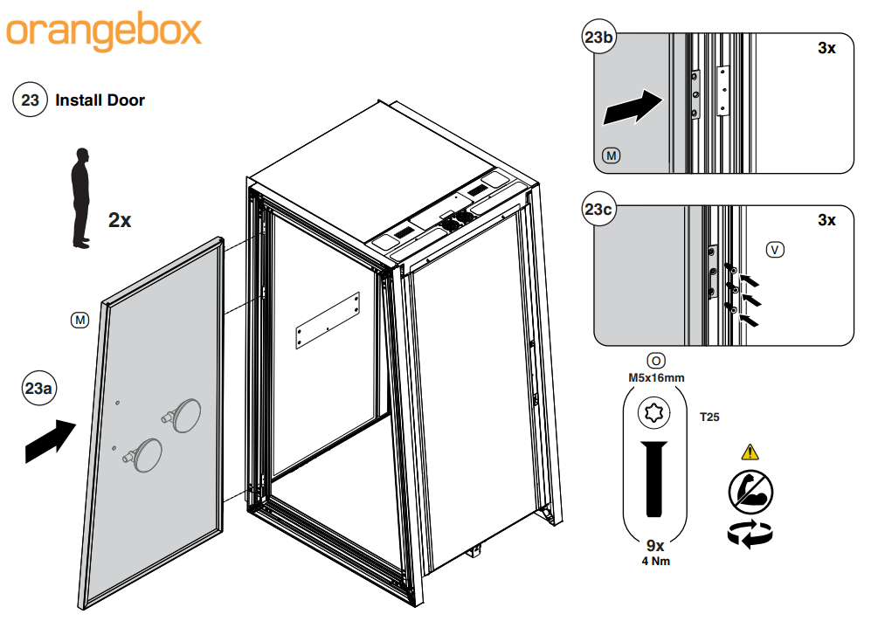
Adding the Door
On the first run in manufacturing the holes in the upright that holds the door are too small – Drill out with a 3/16 drill bitt
Do the same for the pre-drilled holes on the up right for the Door straps and the pre-drilled holes on the door for the door straps

Slide 12
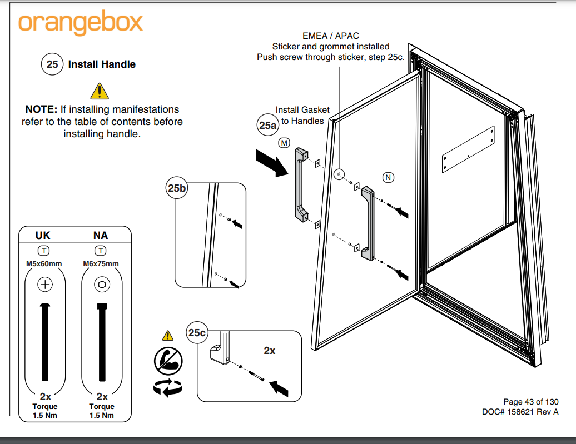
Door Handle
Do not over tighten door – could break the glass
Do not use a drill on the door handle – could break the glass
Door handle screws should have Loctite on them – if they do not it should be added to prevent the handle from coming loose – Loctite 268 is recommended

Slide 13
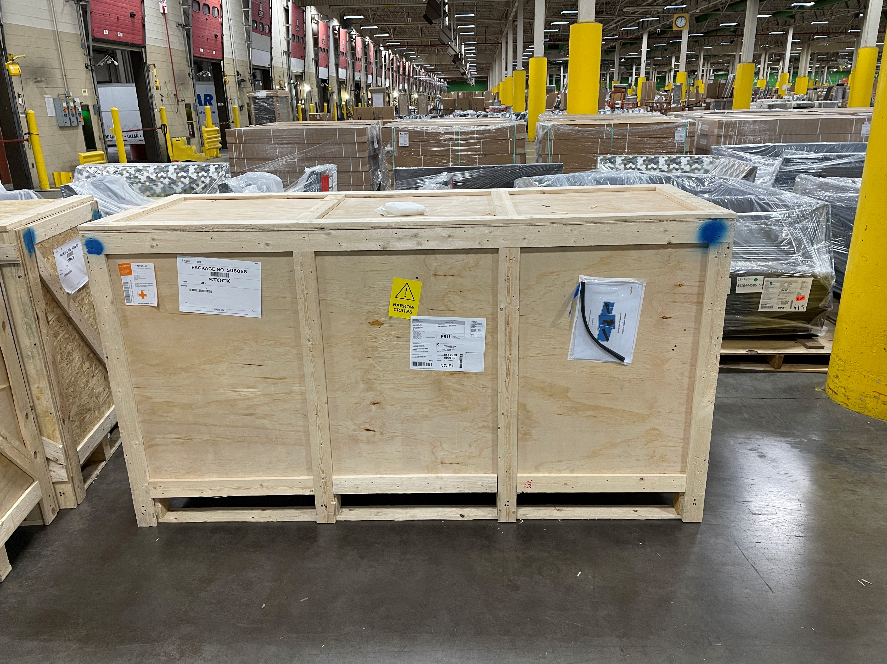
Adding the Door Flipper
Many units have the door flipper attached to the outside of the crate. Remove from the outside of the crate and keep for installation after the door has been installed

